Slide 1
West African Gold Developer
Corporate Presentation
April 2024

Slide 2
DISCLAIMER
The information being released by the Cora Gold Limited (the "Company") today & attached to the RNS (the “Materials”) are being released to provide additional information with respect to the business of the Company. The Materials are not intended to form, & shall not be treated as, the basis of any investment decision or any decision to purchase an interest in the Company. The Materials do not constitute a recommendation regarding the shares of the Company, nor should the Materials be considered as the giving of investment advice by the Company or any of its shareholders, directors, officers, agents, employees or advisers. The Materials do not constitute an offer to sell or an invitation for offers to purchase or acquire any securities or any of the business or assets described herein. The Company has provided the information in the Materials, which do not purport to be comprehensive & have not been fully verified by the Company, or any of their respective shareholders, directors, advisers, agents or affiliates. No representation or warranty, express or implied, is or will be made & no responsibility or liability is or will be accepted by the Company or by any of their respective officers, servants or agents or any other person as to or in relation to the accuracy or completeness of the Materials or the information or opinions contained herein or supplied herewith or any other written or oral information made available to any interested party or its advisers & no responsibility or liability is accepted for the accuracy or sufficiency of any of the information or opinions, for any errors, omissions or mis-statements, negligent or otherwise, or for any other communication, written or otherwise, made to anyone in, or supplied with, the Materials. In particular, no representation or warranty is given as to the achievement or reasonableness of any future projections, management estimates, prospects or returns. Certain statements within the Materials constitute forward looking statements. Such forward looking statements involve risks & other factors which may cause the actual results, achievements or performance expressed or implied by such forward looking statements.
Accordingly, neither the Company nor any of its respective shareholders, directors, advisers, agents or affiliates shall be liable for any direct, indirect or consequential loss or damage suffered by any person as a result of relying on any statement or omission in, or supplied with, the Materials or in any future communications in connection with your interest in the Company. The information set out in the Materials will not form the basis of any contract. The recipient agrees to keep confidential any written or oral information contained herein or otherwise made available in connection with the Company. The Materials must not be copied, reproduced, distributed or passed to others at any time. The Materials have been delivered to you for information only & upon the express understanding that such parties will use it only for the purpose set out above. The Company undertakes no obligation to provide the recipient with access to any additional information or to correct any inaccuracies herein which may become apparent.
Neither the Materials nor any copy of it may be (a) taken or transmitted into Australia, Canada, Japan, the Republic of Ireland, the Republic of South Africa or the United States of America (each a “Restricted Territory”), their territories or possessions; (b) distributed to any U.S. person (as defined in Regulation S under the United States Securities Act of 1933 (as amended)) or (c) distributed to any individual outside a Restricted Territory who is a resident thereof in any such case for the purpose of offer for sale or solicitation or invitation to buy or subscribe any securities or in the context where its distribution may be construed as such offer, solicitation or invitation, in any such case except in compliance with any applicable exemption. The distribution of the Materials in or to persons subject to other jurisdictions may be restricted by law & persons into whose possession this document comes should inform themselves about, & observe, any such restrictions. Any failure to comply with these restrictions may constitute a violation of the laws of the relevant jurisdiction.

Slide 3

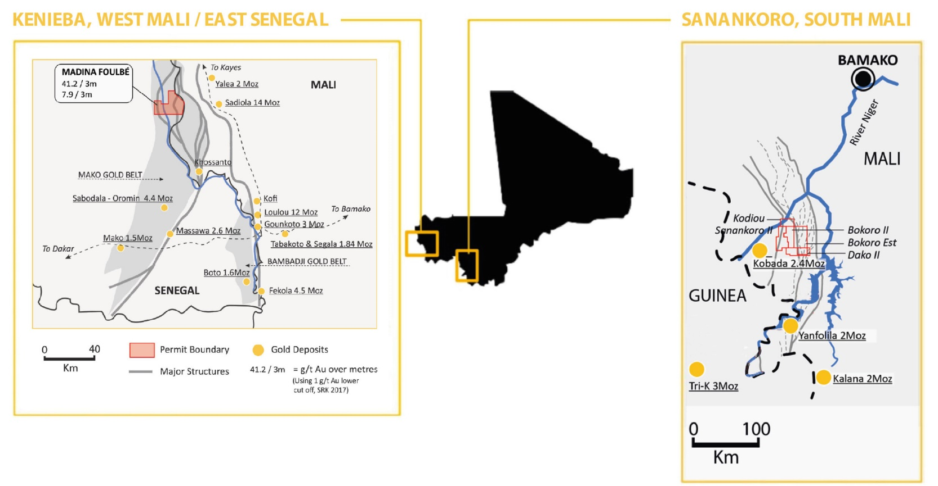
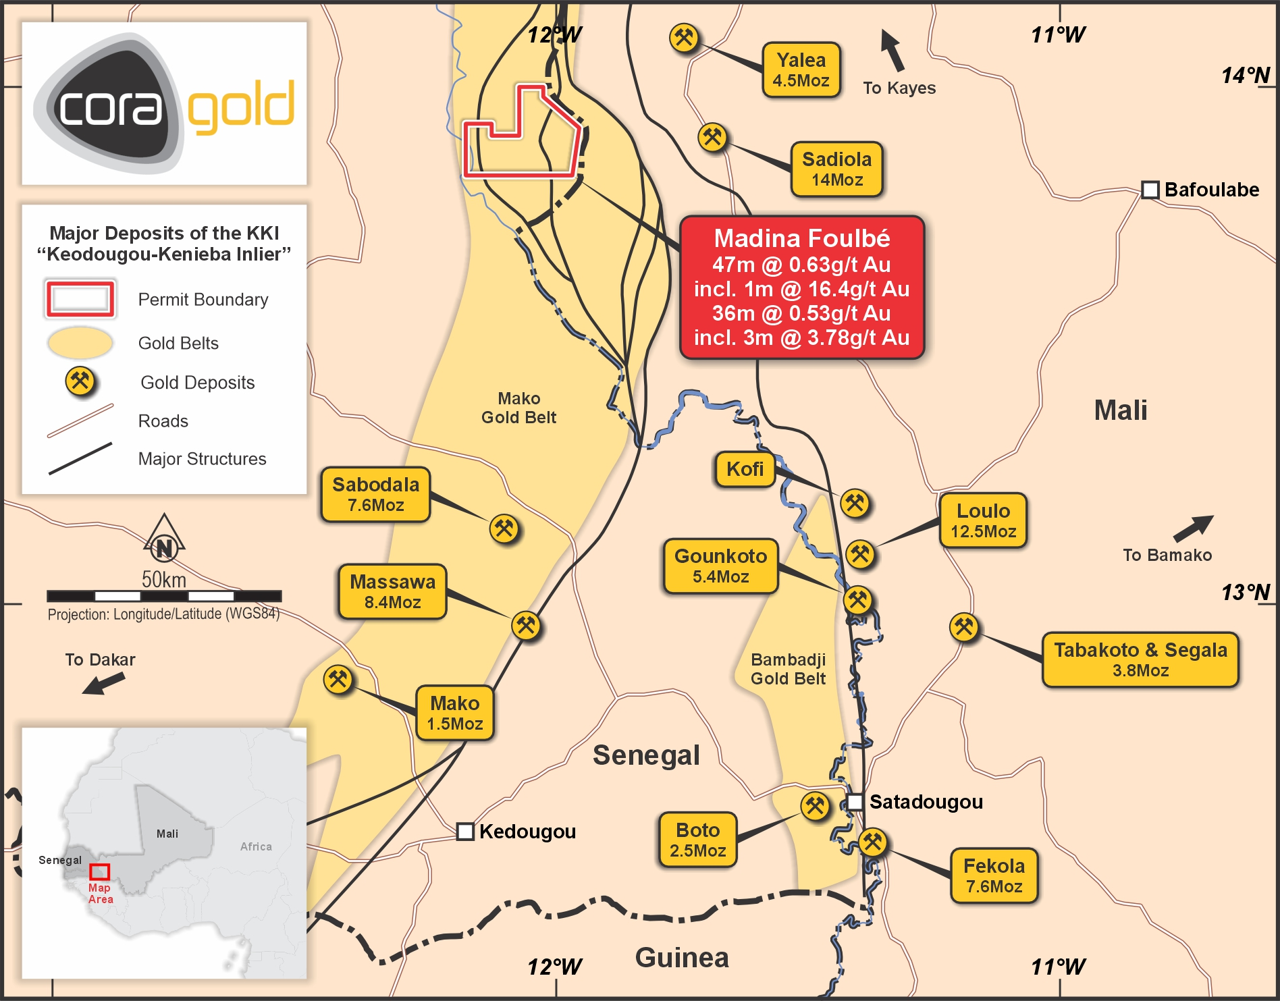


SNAPSHOT
Portfolio of prospective gold assets within two known gold belts in Mali & Senegal & located amongst multiple operational mines
AT A GLANCE
KEY PROJECT
AIM listed company advancing proven gold deposits including developing the Sanankoro Gold Project in the Yanfolila Gold Belt, south Mali, into an open pit oxide mine.
SANANKORO GOLD PROJECT – DFS & Optimised Project Economics show a 52.3% IRR & LOM free cash flow of US$234m at a gold price of US$1,750/oz.
Takes its social and environmental responsibilities very seriously and is committed to ensuring its operations are as sustainable as possible.
Team with proven track record in making multi-million-ounce gold discoveries in Africa, which have been developed into operating mines.

Slide 4
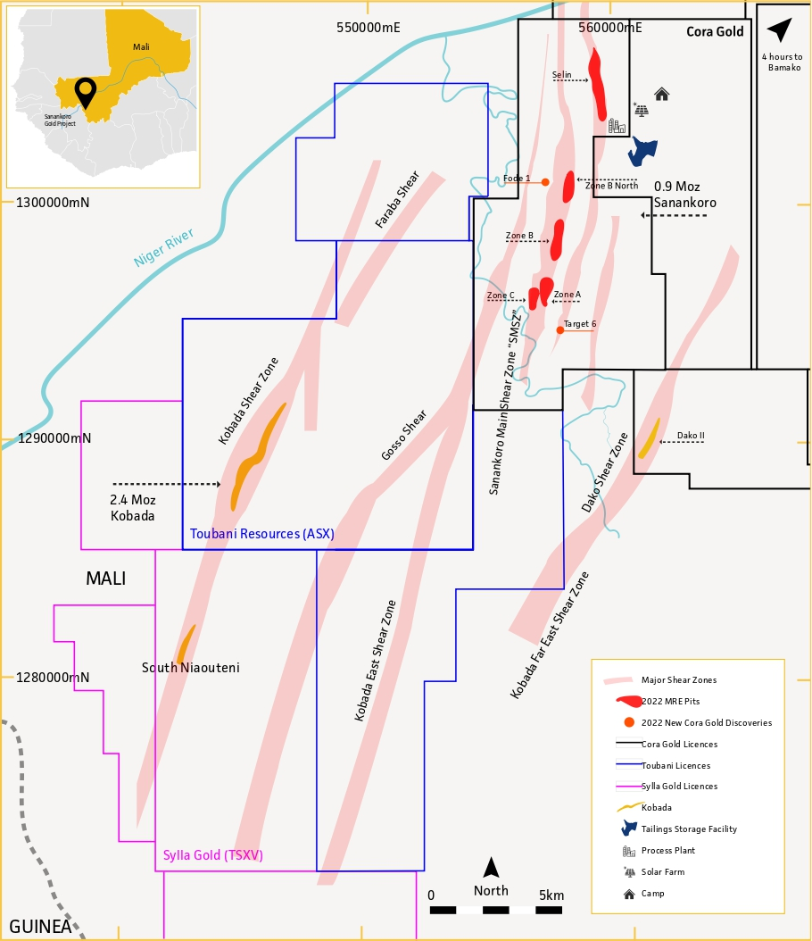
SANANKORO GOLD PROJECT
Advancing to mine construction
Located in Yanfolila Belt, Southern Mali
1.5Mtpa conventional CIL and gravity processing plant from an open pit operation with low strip ratio oxide ore
Delivers post tax & royalties (US$1,750 gold price):
  52.3% IRR
  1.2 years payback period
  6.8 years Reserve life
  +80koz in year 1, c.60koz/year average production
  US$997/oz AISC
  US$90m capex incl. contingency & mining pre-production costs
Environmental permit received

Slide 5
SANANKORO STRATEGY & TIMELINE
STRATEGY
1
2
3
Complete permitting & financing as quickly as possible to commence construction at Sanankoro for a conventional CIL plant
Start delivering strong free cash flow (FCF) from low strip ratio oxide ounces at Sanankoro once in production
Drive organic growth from infill drilling existing Inferred resources and targeting significant exploration potential
Month 1-6* | Month 4 | Month 6 | Month 12 | Month 17 | Month 18 | 18+ months
Engineering & design | Start of earthworks | Start of civil construction | Deliver ball mill to site | Complete TSF & process plant | Pour first gold | Ramp up production
*Subject to lifting of the Government’s permit moratorium

Slide 6
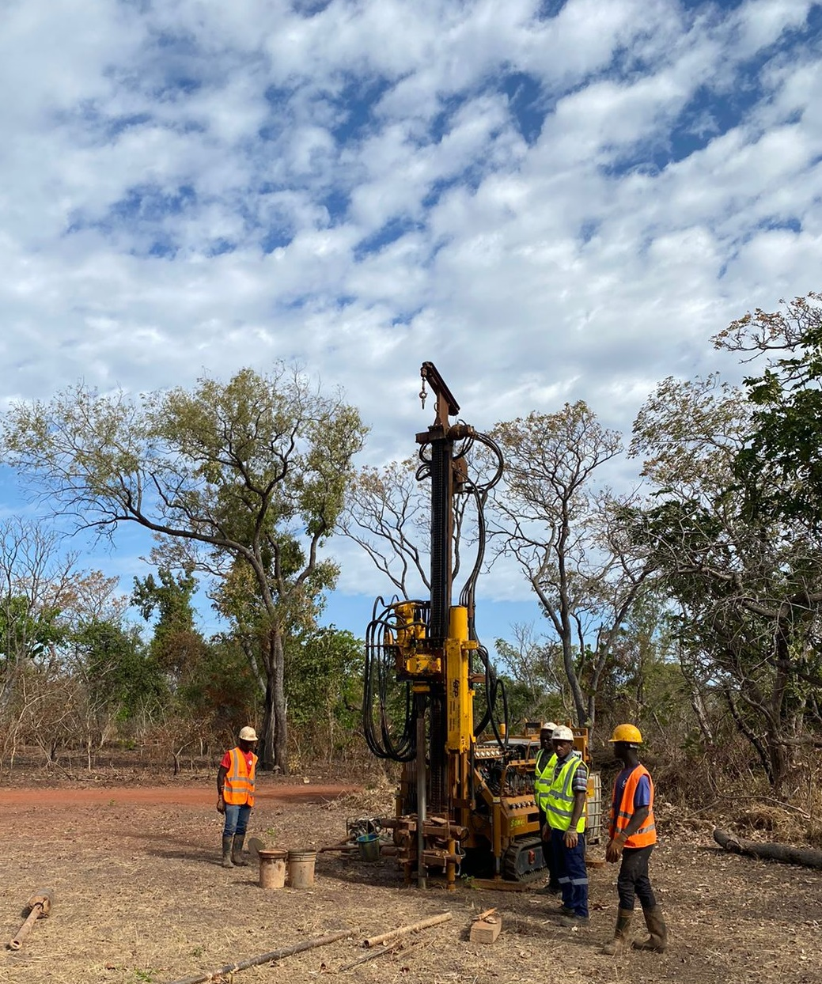
OPERATIONAL READINESS
Poised to fast-track mine construction
Commenced tendering process for Sanankoro, July 2023
  Front-End Engineering and Design (FEED)
  Hybrid power solution & mine camp construction
  Appointed senior management team: Lourens Steenekamp as Project Manager, Frikkie Fourie as Mining Consultant, & Murray Paterson as Head of Geology
Signed US$70m debt Mandate Letter with Atlantique Finance to support Sanankoro construction, June 2023

Slide 7
SANANKORO ECONOMICS
1.5Mtpa throughput plant
Reserves only, post-tax | US$1,750 | US$1,650
First full year production - oz | 84,860 | 84,860
First full year FCF – US$m | 71.8 | 64.2
LoM avg. production/year – oz Au | 56,000 | 56,000
LoM Grade – g/t Au | 1.3 | 1.3
Project CAPEX (incl. contingency) – US$m | 90 | 90
Strip ratio – waste:ore | 4.6:1 | 4.6:1
All in Sustaining Costs – US$/oz | 997 | 992
LoM FCF – US$m | 234 | 207
IRR - % | 52.3 | 43.6
The mine’s economics improve when pit optimised resources (including inferred) are added to mine plan @ US$1,750 Au:
+US$76m additional FCF | +2.5 years additional mine life

Slide 8
STRONG EARLY PRODUCTION & CASHFLOW (US$1,750 gold price & post tax)
Avg 56,000oz
Avg US$997/oz
Avg US$34.3m
Significant Inferred & Exploration target oz to be converted to Reserves
Significant Inferred & Exploration target oz to be converted to Reserves
Significant Inferred & Exploration target oz to be converted to Reserves
Up to 1.37Moz of exploration target; 90% in oxide & transitional to be targeted with future drilling
121koz of additional pit optimised resources to be converted to Reserves would lower strip ratio from an average of 4.61:1 to an average 3.78:1
Grade in start-up year of 1.6 g/t Au & an average of 1.3 g/t Au LoM

Slide 9
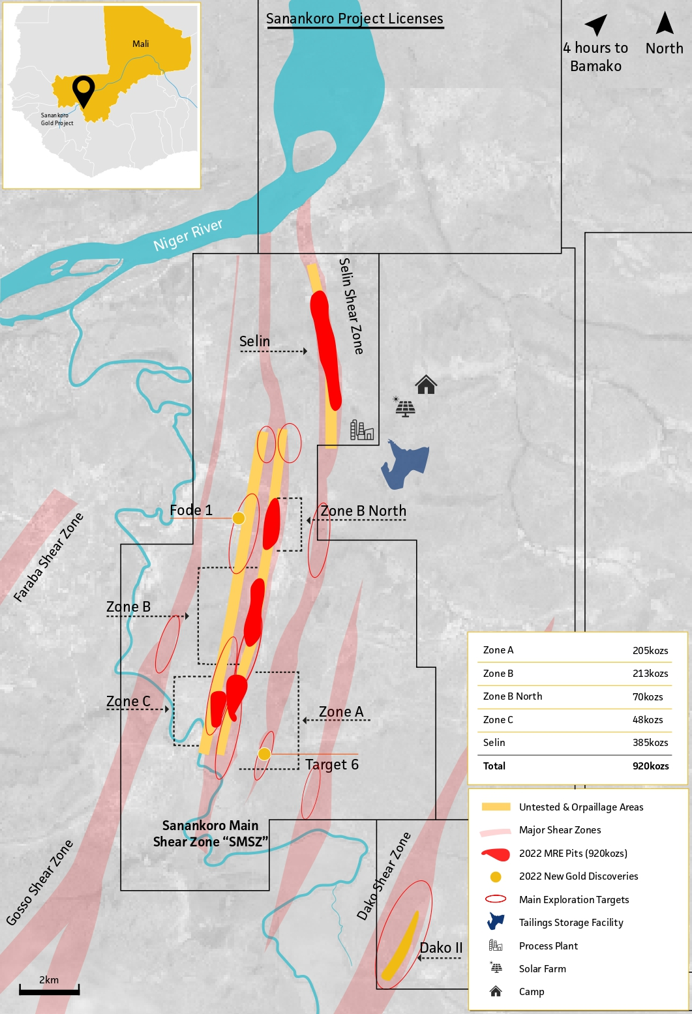
CAPEX & OPEX BREAKDOWN
Pre-production capex of US$90m (incl. contingency & pre-production mining)
Design includes a hybrid power option incorporating solar power
Contractor mining planned from the start of operations
OPEX | US$/T
Mining cost | 2.8
Mining total cost | 15.8
Process & maintenance | 10
G&A | 3.1
C1 costs | 28.9
AISC | 37.5
CAPITAL COST | US$M
Plant costs | 50.4
EPCM & insurance | 5.5
Mining pre-production | 8.9
TSF | 12.7
Other costs (infrastructure, power etc) | 12.5
Total | 90

Slide 10
MAIDEN RESERVES
21 November 2022
Area | Mineral Reserve classification | Material type | Tonnes (kt) | Grade (g/t Au) | Metal content (koz)
Selin | Probable | Oxide | 3,767 | 1.27 | 154.2
 | Probable | Transitional | 519 | 2.38 | 39.8
Total – Selin | Probable | All zones | 4,287 | 1.41 | 194.0
Zone A | Probable | Oxide | 2,752 | 1.32 | 116.8
 | Probable | Transitional | - | - | -
Total – Zone A | Probable | All zones | 2,752 | 1.32 | 116.8
Zone B | Probable | Oxide | 3,048 | 1.13 | 111.0
 | Probable | Transitional | 8 | 1.54 | 0.4
Total - Zone B | Probable | All zones | 3,056 | 1.13 | 111.5
GRAND TOTAL | Probable | All zones | 10,094 | 1.30 | 422.2

Slide 11
MINERAL RESOURCE ESTIMATE
Mineral Resource Estimate
Completed by CSA Global (UK) Ltd, 19 July 2022
Area | Classification | Tonnes (kt) | Grade (g/t Au) | Content (koz)
Zone A | Indicated | 3,977 | 1.31 | 168
 | Inferred | 1,453 | 0.80 | 37
 | Total | 5,430 | 1.17 | 205
Zone B | Indicated | 3,034 | 1.20 | 117
 | Inferred | 3,962 | 0.75 | 96
 | Total | 6,996 | 0.95 | 213
Selin | Indicated | 7,466 | 1.33 | 320
 | Inferred | 1,466 | 1.38 | 65
 | Total | 8,932 | 1.34 | 385
Zone B North | Indicated | 1,661 | 0.97 | 52
 | Inferred | 513 | 1.10 | 18
 | Total | 2,174 | 1.00 | 70
Zone C | Inferred | 1,338 | 1.11 | 48
 | Total | 1,338 | 1.11 | 48
All Zones | Indicated | 16,138 | 1.27 | 657
 | Inferred | 8,732 | 0.94 | 263
 | Total | 24,870 | 1.15 | 920
+14% increase in total ounces from previous MRE in November 2021
Significant upgrade to Indicated category using a 0.4g/t cut off & a US$1,900/oz optimised pit shell
22% increase in oxide Indicated Mineral Resources to 509koz
Comprises 24.9Mt of material at a grade of 1.15 g/t Au, of which 16.1Mt are Indicated Mineral Resources & 8.7Mt are Inferred Mineral Resources for a total 920koz Au
  657koz @ 1.27 g/t Au Indicated category
  263koz @ 0.94 g/t Au Inferred category
MRE updated following the completion of a limited drill programme of 6,922m of reverse circulation (RC) and 897m of air core drilling

Slide 12
EXPLORATION TARGET
Exploration Target* based on drill data estimated to contain between 26.0Mt & 35.2Mt with a grade range of 0.58 - 1.21 g/t Au for a potential content of 490koz Au – 1.37Moz Au
koz Au
Potential to increase content +150% to a total 2.33Moz Au | 3 of the 12 areas are responsible for +50% of the target
Oxide & transitional material make up +90% of the target | Focus on brownfield areas within 8km of existing Mineral Resource
*Completed by independent consultancy CSA Global which also calculated the MRE

Slide 13
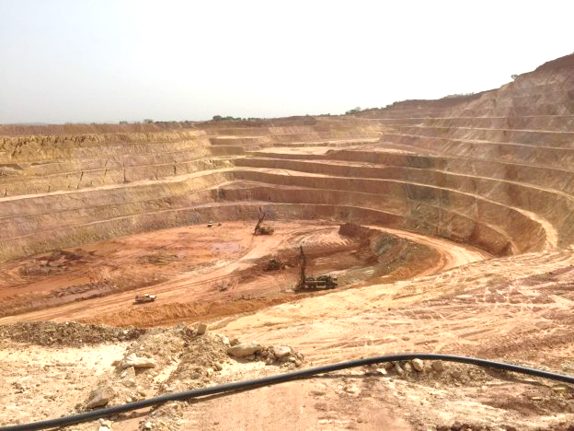
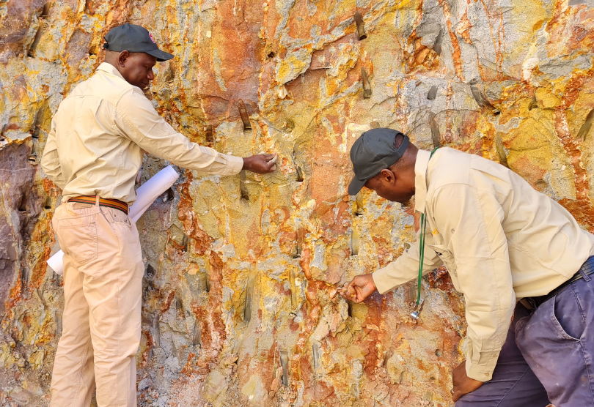
SAPROLITE SOFT ROCK
Siguiri - Anglogold Ashanti (Guinea)
True oxide gold
Saprolite soft rock
Peer Group | No soft rock peers in London Nampala – soft rock & transitional Siguiri & Sadiola – now in hard rock
Characteristics | Heavily weathered rock Deep weathering profile Mine life dominated by soft rock Processing plant designed for mainly soft material
Lower Unit Costs | Mining cost lower – no drill & blast Processing cost lower – limited crushing Capex & maintenance lower than fresh rock mines
Comparator | Robex (TSX.V – RBX; Nampala) is a technical comparator to Sanankoro from an ore & metallurgy perspective - below is a 3-year snapshot of its performance:
Sanankoro – Cora (Mali)
 | FY20 | FY21 | FY22
Gold production | 50,3koz | 46,6koz | 46.7koz
Grade (g/t Au) | 0.93 | 0.81 | 0.82
Recovery | 89.1% | 91.4% | 83.3%
AISC (US$ per ounce sold)* | 950 | 1,501 | 1,457
Average m cap (£)** | 113.0 | 144.7 | 130.2
* Currency converted at an exchange rate of CAD1:USD0.74
** Currency converted from CAD using historical FX daily FX rates

Slide 14
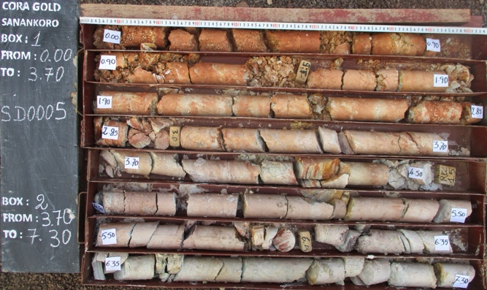
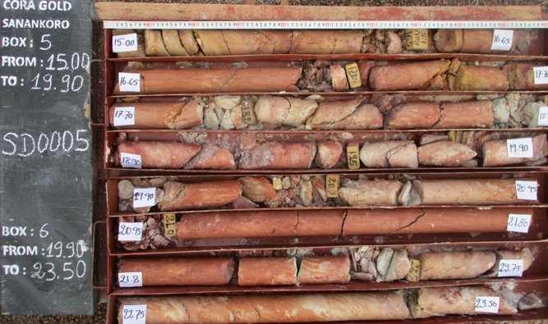
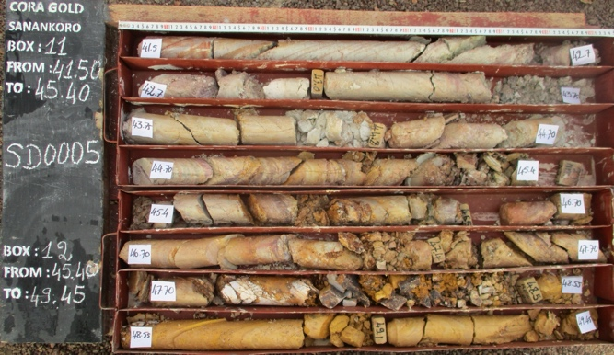
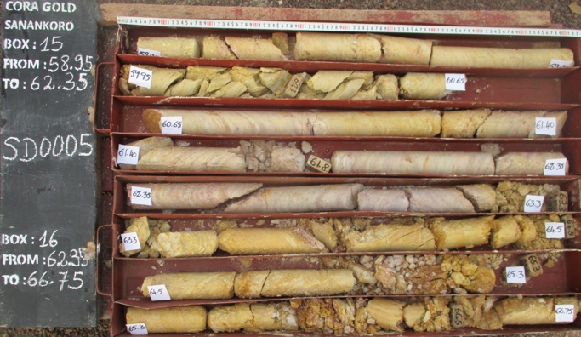
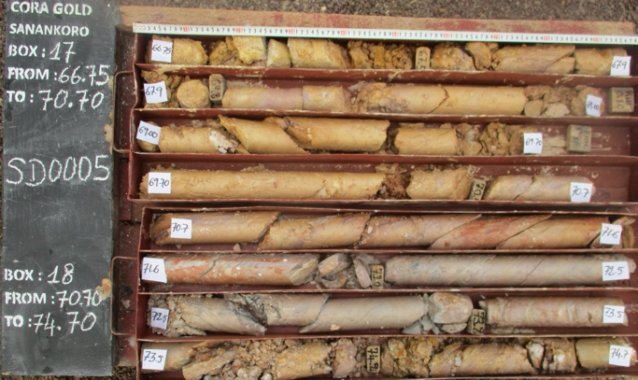
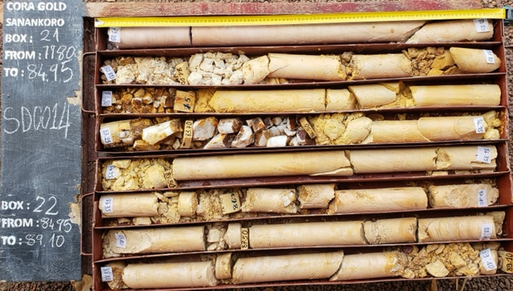
OXIDE ORE
Material at Sanankoro does not become hard rock until depths of +120m
0m
7m
15m
24m
42m
50m
59m
67m
70m
75m
80m
90m

Slide 15
MADINA FOULBÉ
Potential for a large scale, in-situ gold mineralisation
Located within the Mako Geological Belt of the Kédougou-Kéniéba Inlier
Located within the Kenieba Project Area in East Senegal close to several Tier 1 gold deposits
Previous soil geochemistry work defined a large 3km long by 1.6km wide gold anomaly (>20ppb) at the Tambor anomaly
Region serviced by good infrastructure within a mining friendly jurisdiction
Positive results from 2020 reconnaissance drill programme at Tambor:
  47m @ 0.63 g/t Au from 27m, in hole MFC007, including 1m @ 16.4 g/t Au
  36m @ 0.53 g/t Au from 6m, in hole MFC001, including 3m @ 3.78 g/t Au
  27m @ 0.47 g/t Au from 45m, in hole MFC002
Recent field visits confirmed multiple intrusive lithologies over the entire anomaly and that mineralisation is hosted by well-developed sheeted and stockwork quartz vein sets within
2024 Drilling Programme
2,000m RC drilling programme to evaluate the most prospective gold anomalies not previously drill tested started in April to end in May

Slide 16
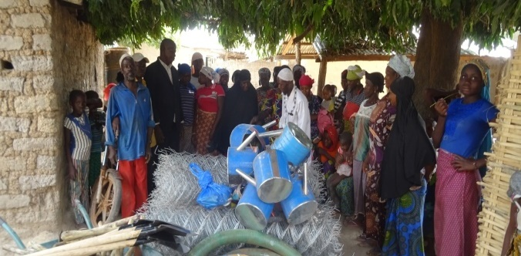
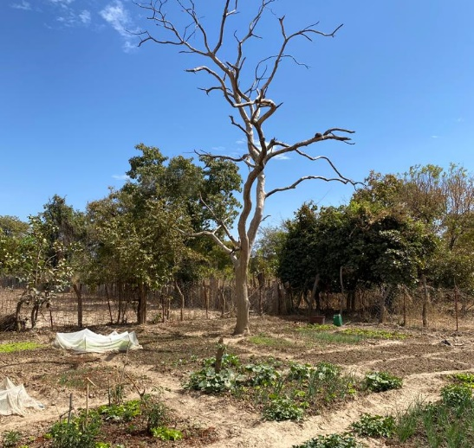
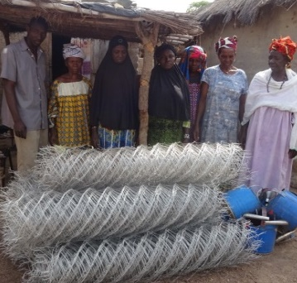
ESG
PERMITTING
Environmental & Social Impact Assessment (ESIA) submitted July 2022 to Direction Nationale de l'Assainissement et du Contrôle des Pollutions et des Nuisances ('DNACPN'), the governing administration for environmental matters in Mali
Environmental Permit awarded October 2022, recognising Cora’s high environmental standards
COMMUNITY ENGAGEMENT
Delivering garden equipment to the Dako community
Committed to operating in ways that engage positively with the local communities & actively involved in programmes focused on alternative livelihoods, healthcare, & education, which include:
Financing a new water well at the Dako community village garden
Donating to the health centre & giving a solar power kit & battery to Sanankoro village
Donating market garden equipment & founding a village saving & credit association at the community of Faragouagnia
Holding a general assembly at the Sanankoro camp to address questions on the potential future developments at Sanankoro from the surrounding communities
Established a market garden at Sanankoro village
Delivering garden equipment to the community of Farangouania

Slide 17

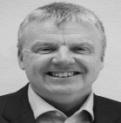
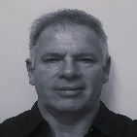
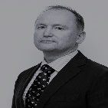

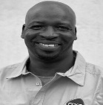
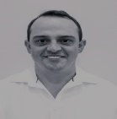
MANAGEMENT
 | Bert Monro CEO & Director | +14 years’ experience within the natural resources industry Previously worked for HUM advancing its +6Moz of gold resources in West Africa & operational gold mine in Mali
 | Craig Banfield CFO & Company Secretary | +25 years’ experience in finance roles in UK and TSX listed resource focused companies Fellow of The Institute of Chartered Accountants in England & Wales
 | Lourens Steenekamp Project Director | An experienced mining professional with a career spanning over three decades Starting with Gold Fields in the early 1990s, he has recently held a project manager position at both Resolute Mining in Mali, and Perseus Mining in Cote d'Ivoire
 | Murray Paterson Head of Geology | Accomplished geologist with extensive experience of mine start-ups in West Africa Has held significant roles for both AngloGold Ashanti and Randgold in Mali – Managing significant drill programmes, overseeing technical studies
 | Siaka Koumare Country Manager | An exploration geologist with over 25 years’ experience in West Africa Has been involved in mineral exploration programmes for gold in West Africa & has worked for a number of successful Canadian & British companies in Mali, Guinea, Sierra Leone & Senegal
 | Djibril Sanogo ESG Manager | +15 years’ experience overseeing environmental and community management in Mali Previously worked for several large gold mining companies including AngloGold Ashanti and Resolute Mining
 | Frikkie Fourie Mining Consultant | A mining consultant with extensive experience in Africa Joined Galiano Gold in 2016 where he was promoted to Vice President of Mining

Slide 18





INVESTMENT CASE
Clear Path Focus on early production & cashflow | Upside Exploration Target highlights significant further resources
New Producer Share appreciation leading to production | Strong Support Diverse investor base including high profile resource investors
Recognised Team Proven expertise to discover & develop mining opportunities | Robust Market Strong gold price outlook
New Producer Outperformance
Share appreciation leading to production

Slide 19
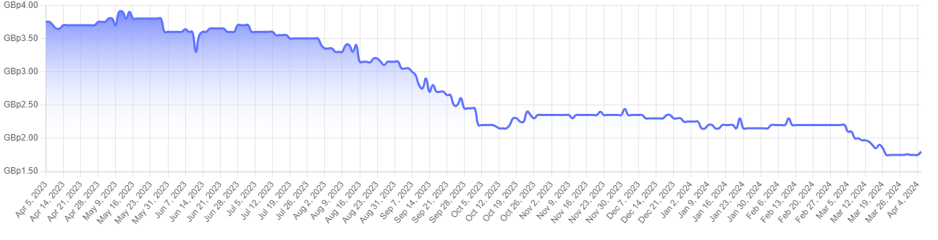
CORPORATE
SNAPSHOT AT 4 APRIL 2024
SIGNIFICANT SHAREHOLDERS
Market Cap | £7.9m
Share Price | 1.75p
52 Week Range | 1.70p-3.98p
Nomad & Broker | Cavendish
SHARE PRICE PERFORMANCE
* wholly owned & controlled by First Island Trust Company Ltd as Trustee of The Nodo Trust, being a discretionary trust with a broad class of potential beneficiaries. Patrick Quirk, father of Paul Quirk (a Non-Executive Director of Cora), is a potential beneficiary of The Nodo Trust.
** a non-grantor trust of which Jeremy Block is the first beneficiary.
*** wholly owned and controlled by First Island Trust Company Ltd as Trustee of The Sunnega Trust, being a discretionary trust of which Paul Quirk (a NED of Cora) is a potential beneficiary.
**** a discretionary trust with a broad class of potential beneficiaries.

Slide 20
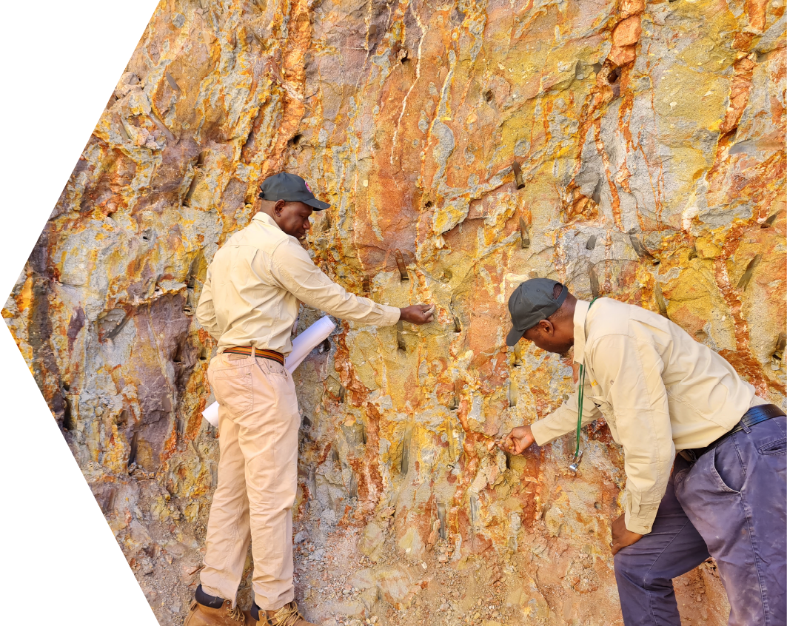
APPENDIX

Slide 21
OPERATING IN MALI
Fourth largest gold producing country in Africa
West Africa is the fastest growing & largest gold producing region, ranking 1st for discoveries over the past decade
Highly developed & active mining culture
Major international companies operate in the country including Barrick, B2Gold, Resolute, & AngloGold Ashanti
Industrial gold production in Mali is building:
  2021 – 63.4 tonnes
  2022 – 66.2 tonnes
  2023 estimated – 66.7 tonnes
Gold mining accounted for c.9% of GDP in 2022 & provided more than half of total tax revenues last year
State revenue from gold mining companies in Mali rose 35% year on year in 2022 to a record $1.3 billion
New mining minister, Amadou Keita, was appointed in July 2023 and a new mining code was passed by Parliament in August 2023
Following these developments, it is expected the permitting moratorium will be lifted shortly
+80% production increase in West Africa over the last decade | 14% of global gold production in 2021 was in West Africa
6 out of top 10 senior gold producers have a presence in West Africa | 67Moz discovered in West Africa over past decade
7.4% of global exploration budget is spent in West Africa | +US$6bn spent in West Africa during the last decade

Slide 22
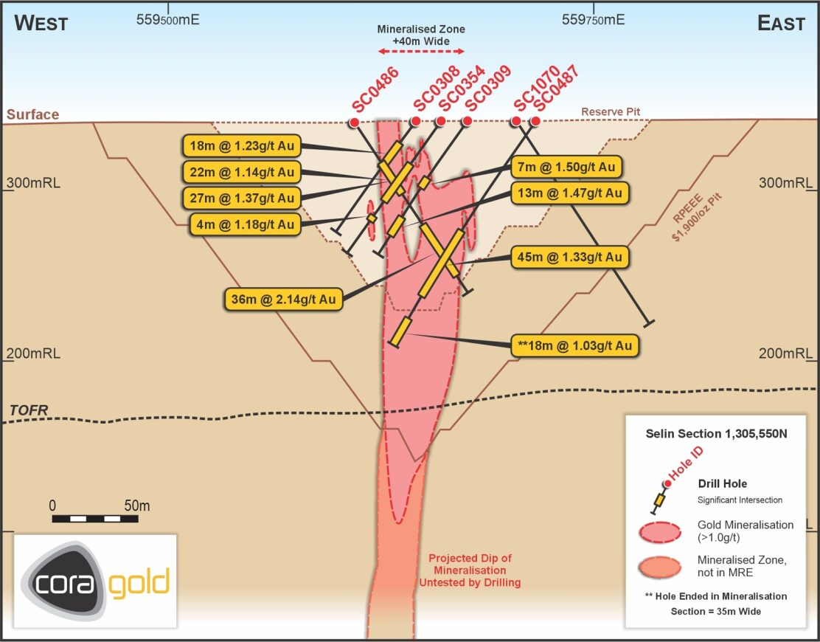
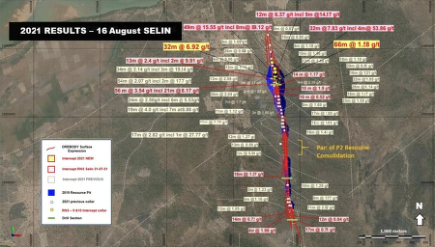
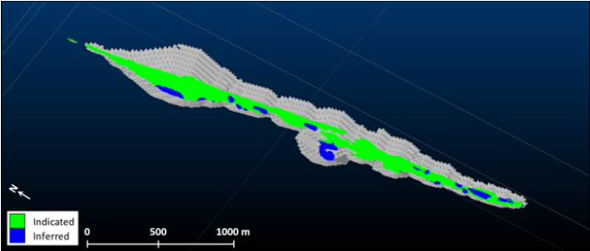
SANANKORO: SELIN
Drilling delivered 550m of increased resource length to maiden MRE – remains open in all directions
Positive results from the middle of Selin where there was previously a gap between two pit shells
Presence of oxide gold mineralisation of potentially economic grades & widths confirmed across prospect
Best oxide intercepts returned from Selin South
Two new discoveries, Fode 1 & Target 6, both in proximity to existing Mineral Resources
Cross-section at Selin showing mineralisation relative to drilling

Slide 23
2021-2022 DRILL CAMPAIGN
Focused on resource growth & upgrading of existing Inferred resources to Measured & Indicated
50,000m drilled across two drill campaigns​
Updated MRE delivered July 2022
Top results from 2021-2022 drilling:
49m @ 15.55 g/t | incl 8m @ 89.12 g/t
19m @ 31.56 g/t | incl 6m @ 95 g/t
2m @ 146.43 g/ t
32m @ 7.83 g/t | incl 4m @ 53.86 g/t
32m @ 6.92 g/t
56m @ 3.54 g/t | incl 21m @ 8.17 g/t
8m @ 19.11 g/t
32m @ 4.43 g/t
21m @ 5.75 g/t
14m @ 8.54 g/t
12m @ 7.61 g/t
13m @ 4.97 g/t

Slide 24
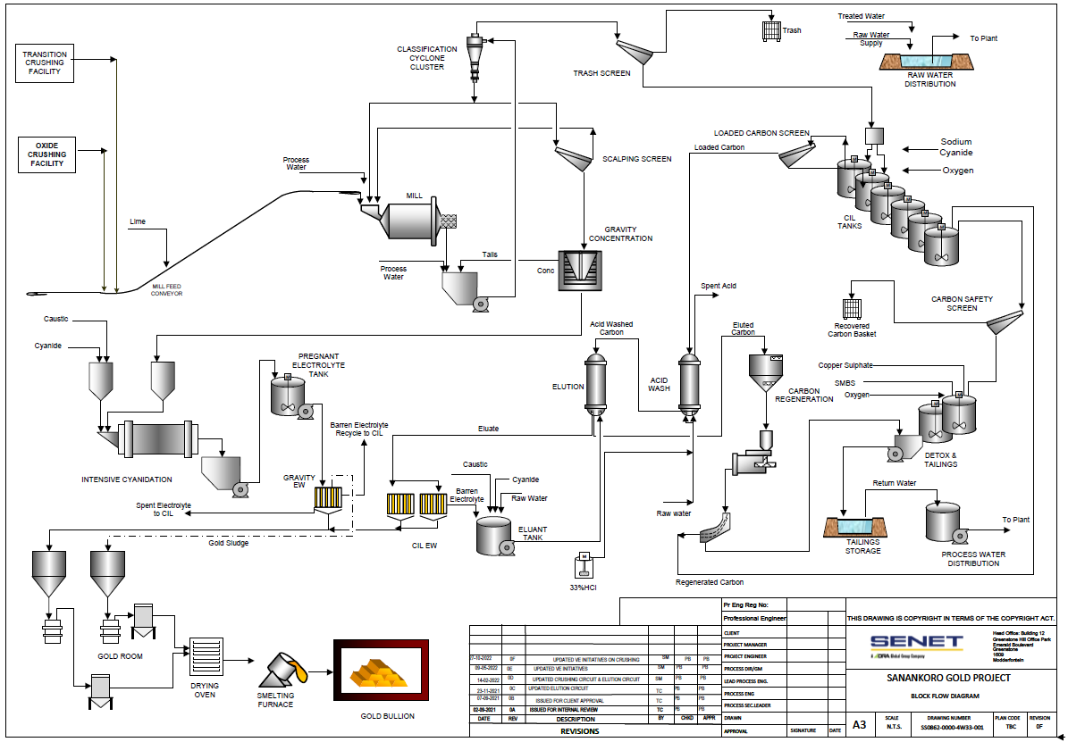
DETAILED CAPEX
FLOW SHEET
Capital items | US$’000
Civil works | 5,122
Earth works | 3,513
Machinery & equipment (a) | 31,704
Infrastructure | 1,194
Transport | 5,432
First fills | 868
Mine camp | 2,206
ESIA channels | 2,859
Project management (b) | 4,500
Insurance & guarantees | 650
Generator / thermal plant | 250
Tailings storage facility (TSF) (c) | 11,895
Resettlement action plan | 1,000
Owner’s costs | 3,814
Mining pre-production | 8,941
Contingency (d) | 5,838
Total pre-production capital | 89,787
Sustaining & closure capital (e) | 57,868
Total LOM capital | 147,655
Conventional gravity & CIL circuit
As per DFS: (a) US$34,204k; (b) US$10,028k; (c) US$20,688k; (d) US$7,750k; (e) US$59,857k

Slide 25
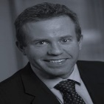

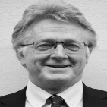
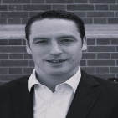
NON-EXECUTIVE DIRECTORS
Track record of discovery & development in Africa
 | Ed Bowie NED & Chairman | +24 years’ experience within the wider natural resources industry, in June 2023 he was announced as the new CEO of Beowulf Mining Started his career with SAMAX Gold in Tanzania before going on to work in equity research & corporate finance role
 | Paul Quirk NED | +15 years’ operational experience in mining focused in Africa including as a Country Manager of MPD Congo SA in the Republic of Congo Partner at Lionhead & experience in financing projects
 | David Pelham NED | A mineral geologist with +35 years global exploration experience He has overseen the discovery & early evaluation of the +6Moz Chirano Gold Mine in Ghana, as well as Hummingbird’s 4.2Moz Dugbe gold deposit in Liberia
 | Andrew Chubb NED | Since 2014, Andrew has worked as a Partner at natural resources investment bank Hannam & Partners as Head of Mining He is also a Director at Metals Exploration Plc

Slide 26
Bert Monro, CEO
ceo@coragold.com
www.coragold.com
@coragold

